Slide 1
Teaching Python to Dummies

Slide 2
The IDLE
“Integrated Development Environment”
Creating a new File
Print()
Running a File
The Command Line

Slide 3
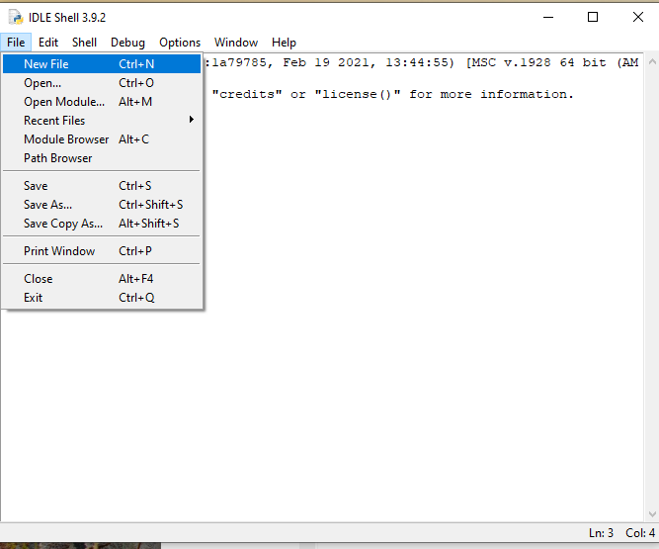
Creating a new File

Slide 4
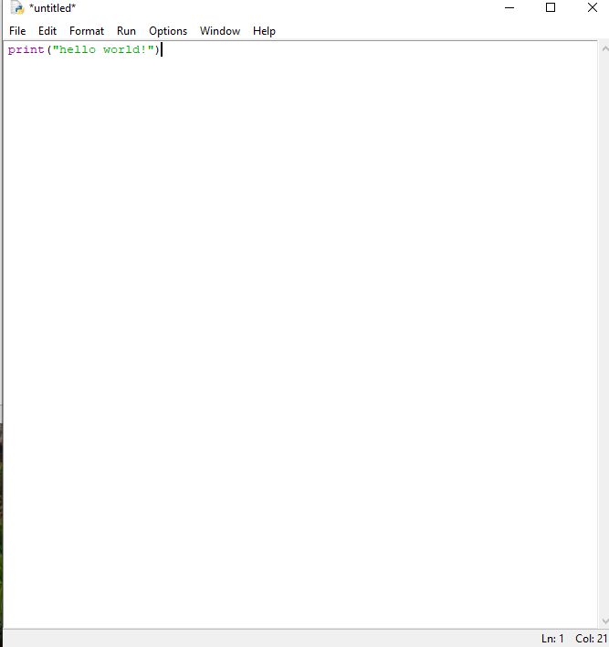
Print()

Slide 5
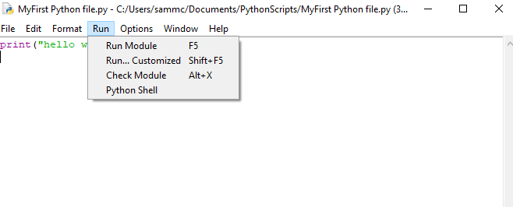
Running a File – Save it First!

Slide 6
So what actually is coding
A set of instructions
Instructions are done one after the other (sequential)
Computer will only do what you tell it to do
Don’t worry you can’t break anything. It’s impossible

Slide 7
Your first “proper” program
So what even are functions ?
Print()
Input()
Variables
Assignment
“adding words”

Slide 8
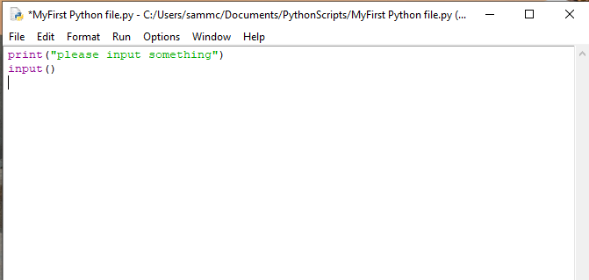
The Input Function

Slide 9
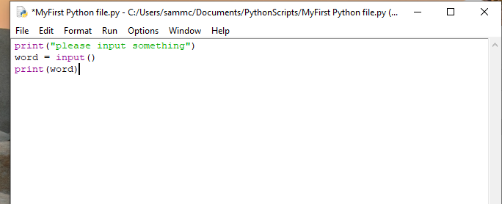
Variables and assignment

Slide 10
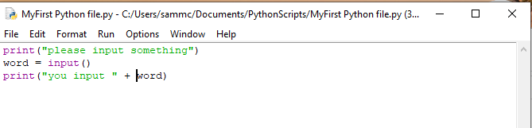
“adding words”

Slide 11
Your Task
Make me a program that asks for two separate words and then outputs or “prints” them to the command line (in one go!)
Whoever does it first gets a gold bar or a kitkat (not conor)

Slide 12
Data Types – The basics
Why we need them
What they are
What are the data types?
Int
Str
Bool
Float

